Slide 1


EEE 416 – Microprocessor and Embedded Systems Laboratory
Jan 2026 Level-4 Term-I Section A2
Project Proposal
AI Driven Bangla Braille Learning Device
Submitted by – Group 08
Santu Nag
2106055
Md. Adib Hasan Audhi
2106055
Mishat Hasan Milon
2106059
Khalid Mehebub
2106065
1
Bangladesh University of Engineering and Technology
Department of Electrical and Electronic Engineering

Slide 2
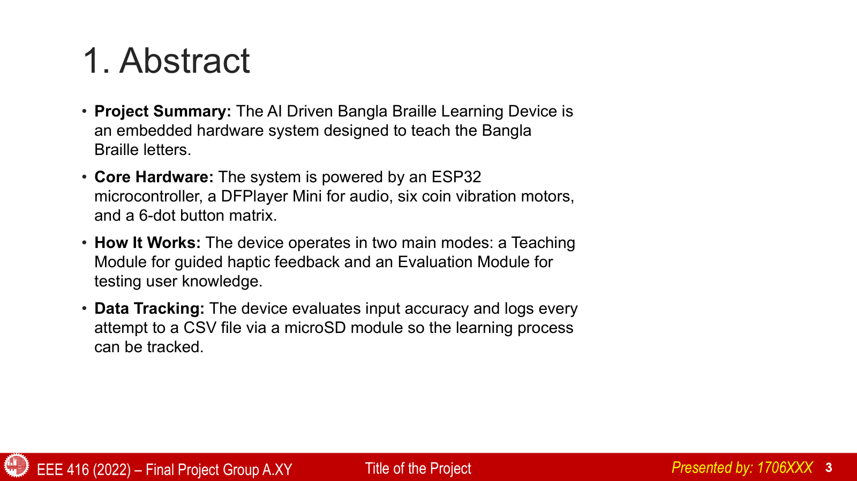
EEE 416 (2026) – Final Project Group 08
Presented by: 2106055

Slide 3
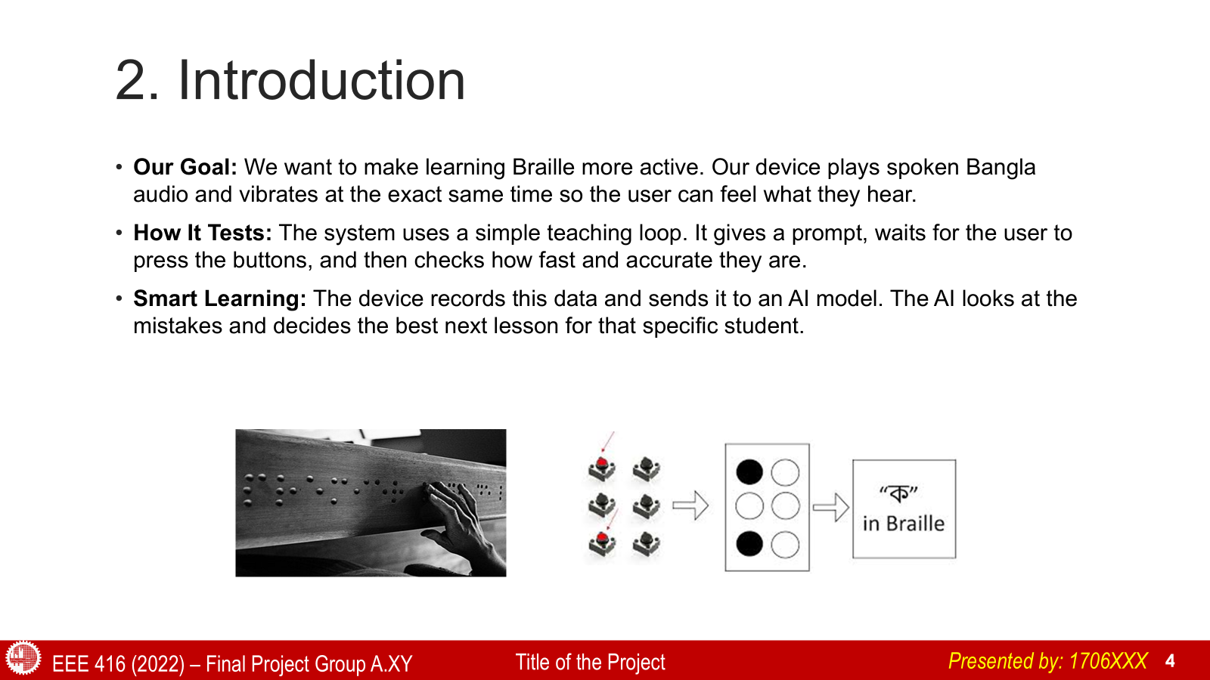
EEE 416 (2026) – Final Project Group 08
Presented by: 2106055

Slide 4
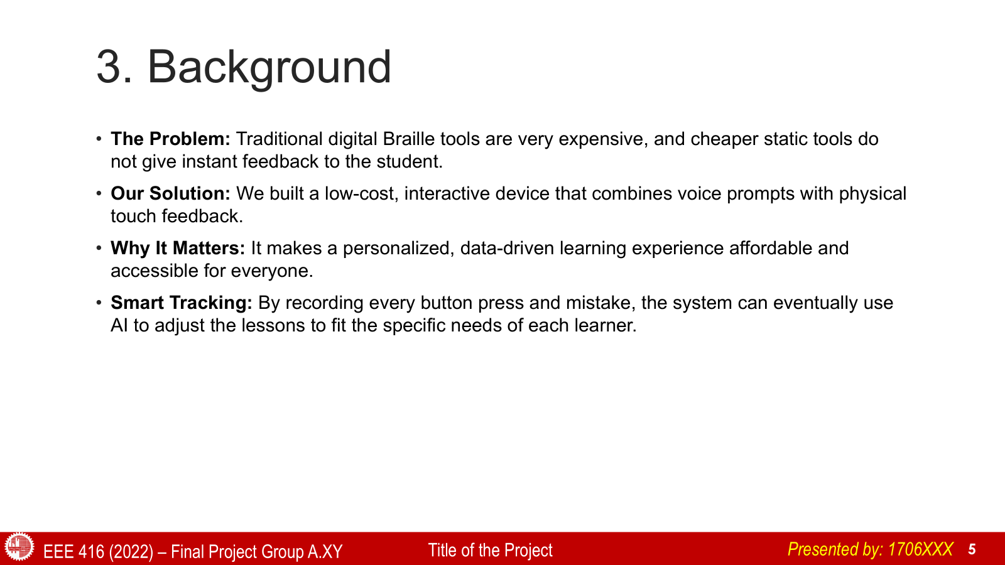
EEE 416 (2026) – Final Project Group 08
Presented by: 2106055

Slide 5
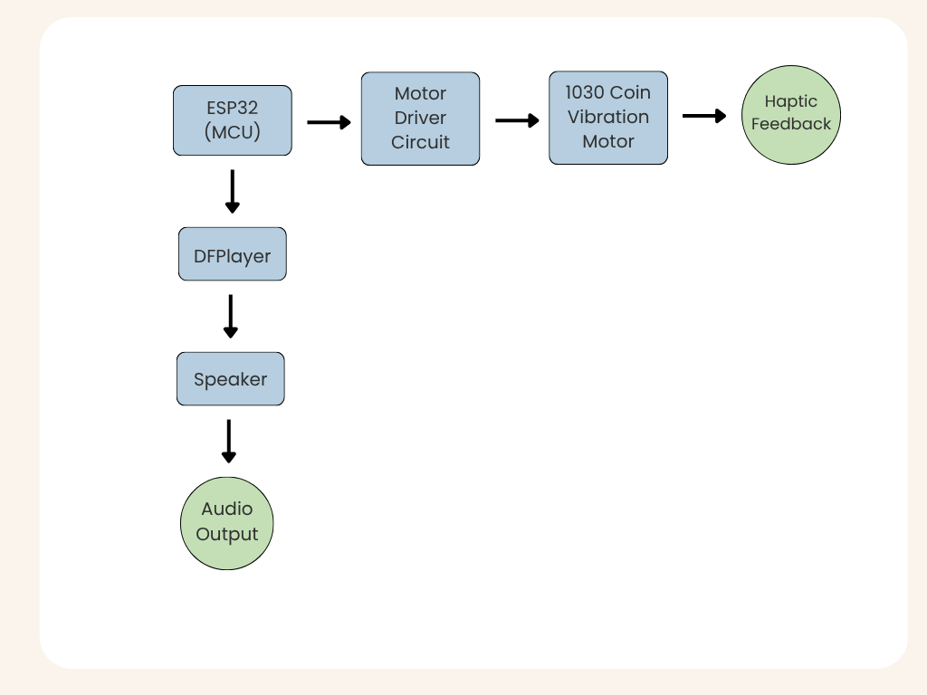
4. Methodology
Haptic Teaching Module
Multisensory Learning:
i. Auditory Pathway: ESP32 selects a letter and commands the DFPlayer module to play the corresponding audio prompt.
ii. Haptic Pathway: ESP32 triggers the motor driver circuit to activate the combination of six 1030 coin vibration motors
EEE 416 (2026) – Final Project Group 08
7
Presented by: 2106056

Slide 6
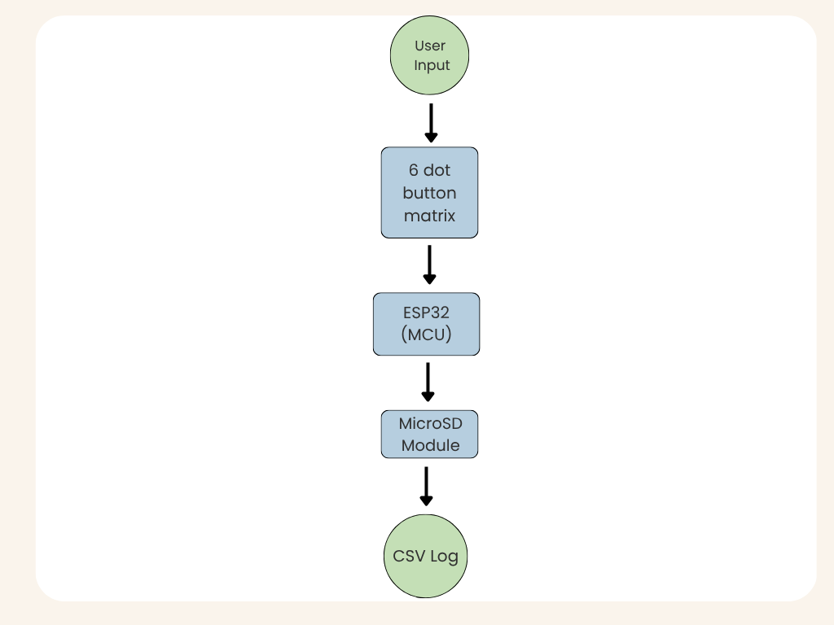
  Methodology
Interactive Evaluation Module
Real Time Input & Assessment:
i. Tactile Input Pathway: The learner presses a combination of keys on the 6- dot button matrix to enter a Braille chord. The ESP32 latches this physical input and extracts behavioral features such as response time, accuracy, retry count etc.
ii. Edge AI and Logging: ESP32 processes the user input and logs the attempt accuracy and features such as response time, retry count etc to a CSV file via the microSD module to evaluate the learning process.
EEE 416 (2026) – Final Project Group 08
Presented by: 2106056

Slide 7





5. Real time Operational Workflow
1
2
3
4
5
SIMULATION
DATABASE
TINY ML-MODEL
ESP-32
ANALYSIS
EEE 416 (2026) – Final Project Group 08
Presented by: 2106059

Slide 8
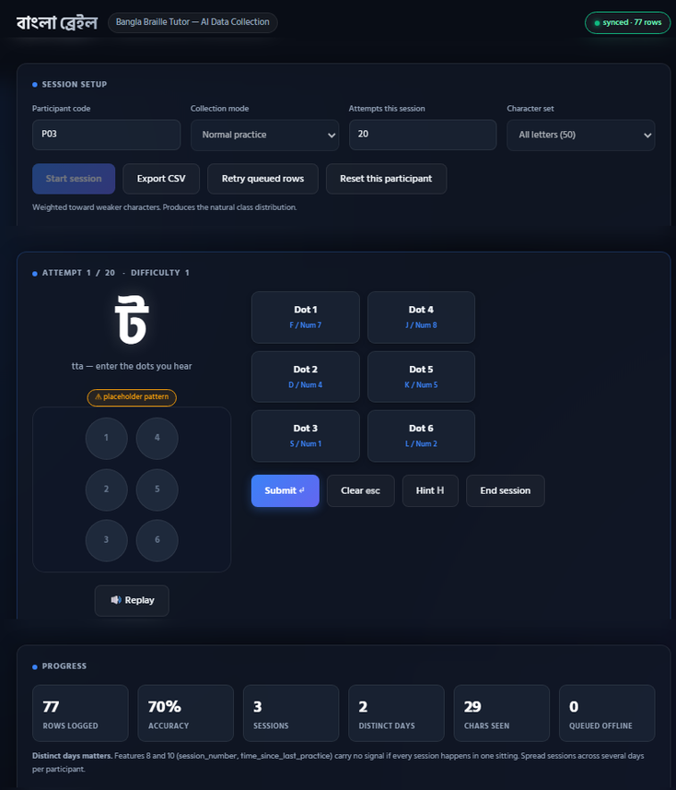
Simulation
SAMPLED BEFORE THE ATTEMPT
MEASURED DURING
READ AFTER SCORING
  character id
  prev accuracy
  prev mastery
  prev mistakes
  prev confidence
  session number
  difficulty level
  time since last practice
  response time
  press duration
  retry count
  hint count
  current streak
  wrong streak
EEE 416 (2026) – Final Project Group 08
Presented by: 2106059

Slide 9






Model Architecture
INPUT
DENSE 32
DENSE 16
DENSE 3 — softmax
14 features
ReLU
ReLU
confidence state
51 parameters
DENSE 6 — softmax
teaching action
480 parameters
528 parameters
102 parameters
EEE 416 (2026) – Final Project Group 08
Presented by: 2106059

Slide 10
Model Output And Performance
OUTPUT 1 — TEACHING ACTION
OUTPUT 2 — CONFIDENCE STATE
MODEL PEREMETER
6 classes
3 classes
  Trainable parameters: 1,161
  Float32 model: ~4.6 KB
  After int8 quantization: ~ 5.928 kB
  Inference time: < 1 ms
  Training time: < 30 s, CPU
  Repeat
  Hint
  Normal practice
  Review previous
  Increase difficulty
  Word practice
  Confident
  Hesitant
  Guessing
EEE 416 (2026) – Final Project Group 08
Presented by: 2106059

Slide 11
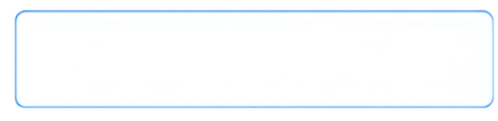

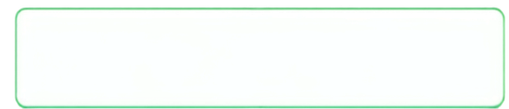








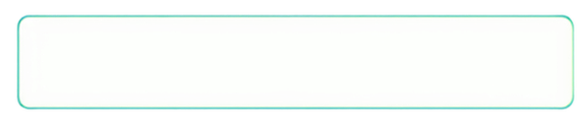
Real Time Testing In Offline Mode
Audio Prompt
  Speaker plays a letter sound.
Student Input
  Student presses the Braille dot buttons.
Feature Extraction
  ESP32 collects 14 input features.
AI Model Inference
  AI model decides teaching action and confidence.
Feedback
  Speaker and vibration give feedback based on the result.
Offline Logging
analytics in a mobile app
  Data is saved to microSD card.
EEE 416 (2026) – Final Project Group 08
Presented by: 2106059

Slide 12
6.System Design Considerations (CO2-b)
1
1. Safety Considerations
  Low-Voltage Electrical Safety: Operates on a safe 5V DC supply
  Zero Electromagnetic Radiation (RF Safety): WiFi and Bluetooth are explicitly to eliminate RF radiation risks for young learners during close-contact use.
  Tactile Comfort: Micro-coin vibration motors calibrated for gentle, non-fatiguing haptic feedback on sensitive fingertips.
2
3
4
EEE 416 (2026) – Final Project Group 08
Presented by: 2106065

Slide 13
3.System Design Considerations (CO2-b)
1
2. Cultural Considerations
  National Bangla Braille Code: Incorporates all 50 characters (11 vowels + 39 consonants + combining marks) following the official Bangladesh National Braille Standard.
  Native Voice Prompts: Uses clear, localized Bangla audio guidance (0001.mp3–0050.mp3) for culturally natural and intuitive learning
2
3
4
EEE 416 (2026) – Final Project Group 08
Presented by: 2106065

Slide 14
6.System Design Considerations (CO2-b)
1
3. Societal Impact & Accessibility
  Inclusive Literacy: Empowers visually impaired children and adults in Bangladesh with an affordable, self-paced learning tool.
  Low-Cost Accessibility: Built using low-cost embedded hardware as an alternative to expensive imported refreshable Braille displays.
  Data Privacy: Runs 100% offline on-device inference without recording or uploading personal voice data to the cloud.
2
3
4
EEE 416 (2026) – Final Project Group 08
Presented by: 2106065

Slide 15
6.System Design Considerations (CO2-b)
1
4. Environmental Considerations
  Paperless Braille Education: Replaces single-use, heavy embossed Braille paper sheets, significantly reducing paper waste and tree harvesting.
  Energy-Efficient Design: Low power consumption, suitable for battery and solar-powered usage in rural, off-grid areas.
  Compact Hardware Footprint: Minimal component usage with durable, long-lasting solid-state electronics.
2
3
4
EEE 416 (2026) – Final Project Group 08
Presented by: 2106065

Slide 16
6. Sustainability & Impact Evaluation(CO-4)
1. Societal Context & Impact
  Democratizing Braille Education: Provides an affordable local embedded solution as an alternative to expensive imported refreshable Braille displays
  Adaptive & Inclusive Learning: Enables self-paced, AI-assisted learning for blind and visually impaired individuals in Bangladesh without requiring constant 1-on-1 human supervision.
  Social Scalability: Designed for easy deployment in special education schools, rural NGOs, and underprivileged communities
EEE 416 (2026) – Final Project Group 08
Presented by: 2106065

Slide 17
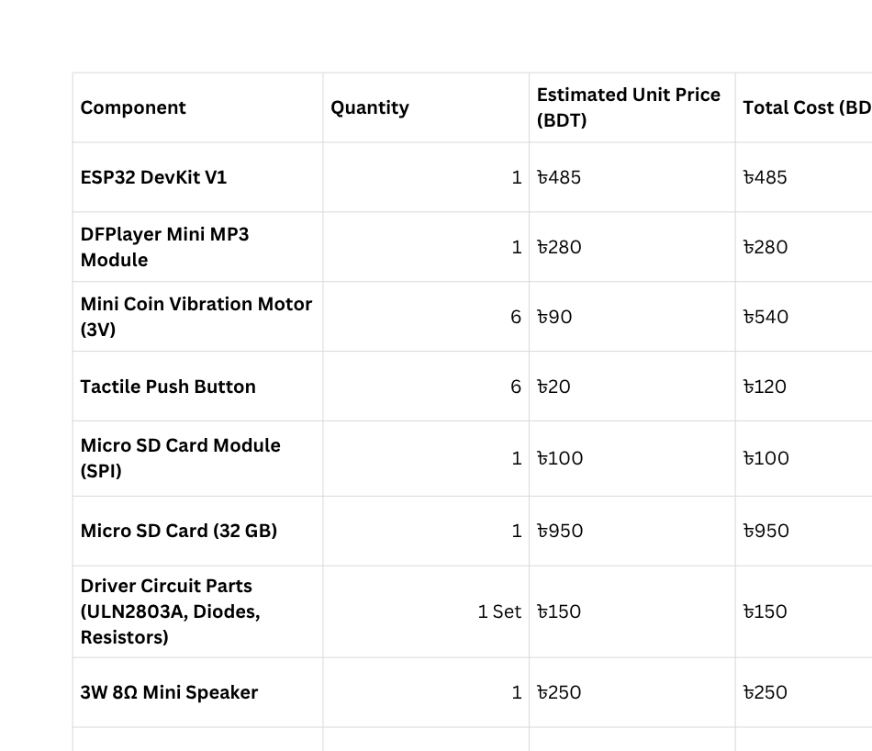
7. project management and cost analysis
EEE 416 (2026) – Final Project Group 08
Presented by: 2106065

